Slide 1
CHAPTER 10
Fertility, Contraception,
and Abortion

Slide 2
Menstruation Across Cultures
Menarche: onset of menstruation, one of the most apparent markers of puberty in females:
  Time of celebration within some cultures.
Reactions and experiences vary within families and across cultures:
  Regarding females as unclean during menses.
  Forbidding sex during menstruation:
    Does not have any biological basis.
  Forbidding activities such as prayer.

Slide 3
Menses
Menses: blood and cellular debris that is discharged from the uterus during the menstrual cycle.
Related taboo is the idea that blood and bodily fluids are contaminating.
History of capturing menses:
  Placing cloth wadding near the vulva or some type of absorbent material inside the vagina.
  Wearing something to keep the cloth in place.

Slide 4
Technologies Available for Menses
Disposable sanitary napkins:
  Disadvantages:
    Occasional leakage of blood.
    Pads may be visible in tight fitting clothing.
    Not well-suited for swimming.
    Some may experience chafing of the labia, clitoris, or other regions of the vulva.
Vaginal tampons:
  Sometimes associated with an increased risk of a fatal bacterial infection known as Toxic Shock Syndrome.
  Preferred for athletics as well as swimming.
Insertable menstrual cups that rest against the cervix:
  Address concern regarding impact of non-biodegradable components of tampons and pads.

Slide 5
Menses Around the World

Slide 6
Menstrual Cycle
Menstrual cycle: a regular cycle involving hormones produced in the brain that affect the ovaries and hormones produced in the ovaries that affect the endometrium.
  Varies between 20 and 36 days.
Menstrual phase (day 0-5): blood and tissue flow as the endometrium lining falls, called menstruation.
  Follicular / proliferative phase (day 6-14):
  Ovarian follicles develop.
  Pre-ovulatory phase: endometrial lining thickens.
  Ovulation occurs and typically one ovum is released.
Luteal / secretory phase (day 14-28):
  Time after ovulation until menstruation begins.
  Endometrial lining thickens as it prepares for potential implantation of a fertilized ovum.

Slide 7
Sex Hormones and the Menstrual Cycle
Gonadotropins: signaling hormones secreted by the hypothalamus in the brain, affects the pituitary gland.
Follicle-stimulating hormone (FSH):
  Stimulates the ovaries to produce estrogen and results in egg cells which mature inside sacs in the ovaries.
  Causes endometrium lining in the uterus to thicken.
Luteinizing hormone (LH):
  Causes the ovary to release a mature ovum.
  Stimulates the development of the corpus luteum in the ovary producing progesterone.
Corpus luteum: portion of the follicle which is left after an ovum has been released:
  Produces progesterone to signals the endometrium in the uterus to further thicken.

Slide 8
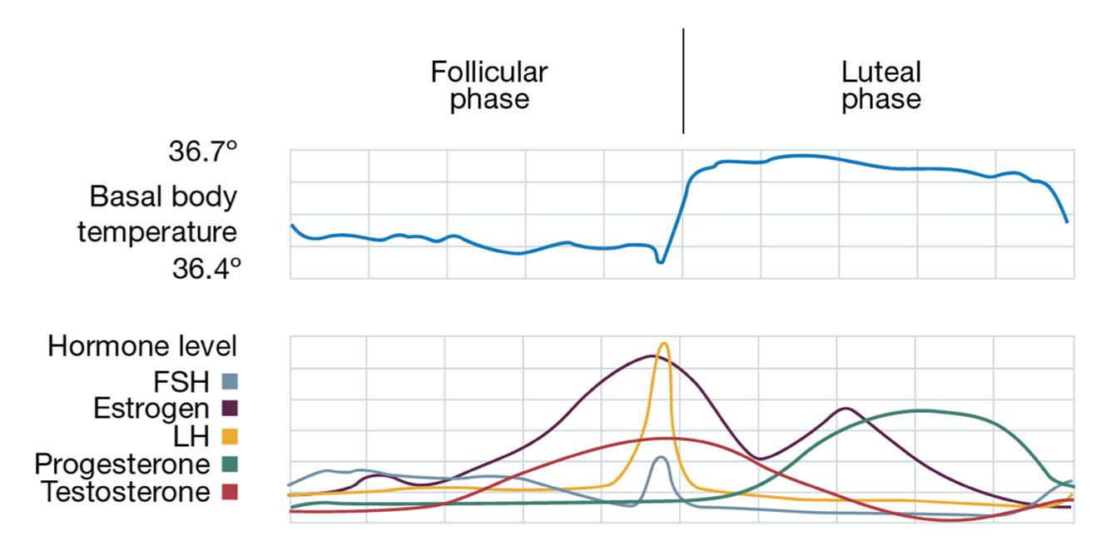
Menstrual Cycle

Slide 9
Menstrual Cycle (continued)

Slide 10
Endometrium
Endometrium: the mucous membrane lining the uterus.
Composed of three layers of cells:
  Stratum basale (deepest)
  Stratum spongiosum (middle)
  Stratum compactum (surface-most layer)
Thickens every time ovulation occurs.
Fertilized egg implants into the endometrium and then secretes hormones that cause the uterine lining to thicken.

Slide 11
Menstruation Stoppage
During pregnancy, a fertilized egg:
  Implants into the endometrial lining.
  Secretes human chorionic gonadotropin (hCG) hormone.
    Signals the corpus luteum in the ovaries to continue progesterone secretion to maintain the endometrium.
During breastfeeding:
  Prolactin secreted in the brain suppress LH:
    Ovulation does not occur.
    Corpus luteum does not secrete the higher levels of estrogen and progesterone.

Slide 12
Types of Placenta and Uterus Connection
Epithelochorial: mother’s uterus has a weak connection with the placenta:
  In mammals that do not menstruate.
Endotheliochorial: placenta enters more deeply into the tissue of the uterus.
Hemochorial: placenta enters blood vessels from the mother penetrating deeply into the uterus:
  Includes all the mammals that menstruate.

Slide 13
Research Focus
Emera, Romero, & Wagner, 2012:
  Evolutionary perspective on menstruation in hemochorial species:
    High demands of pregnancy in such species puts selective advantage on ending suboptimal pregnancies, or when biologically sufficient resources are unavailable to sustain pregnancy.
Thicker uterine lining serves as defense from invasive disruption of the uterine blood vessels.
Uterine cells respond to fetal genetic abnormalities with spontaneous abortion or miscarriage: end of pregnancy due to natural processes.

Slide 14
Mittelschmerz
Mittelschmerz: mid-cycle pain experienced during ovulation which may continue for several days after ovulation.
Caused due to the rupture of the follicular wall that occurs during ovulation.
Can last from a few hours to several days.

Slide 15
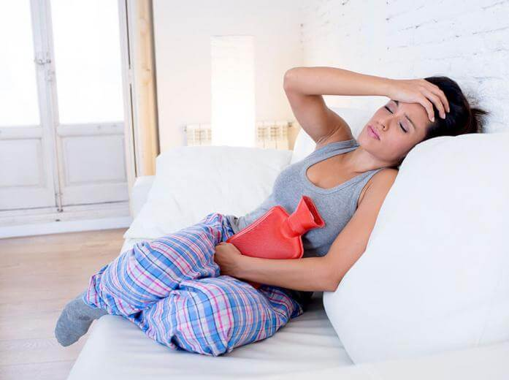
Premenstrual Syndrome (PMS)
Premenstrual Syndrome (PMS): emotional and physical discomfort accompanying the menstrual cycle.
Marked by mild-to-moderate physical discomfort:
  Abdominal cramping
  Bloating
  Water retention
  Swollen or tender breasts

Slide 16
Premenstrual Dysphoric Disorder (PMDD)
Premenstrual dysphoric disorder (PMDD): characterized by severe levels of emotional and physical discomfort accompanying the menstrual cycle.
Changes in appetite, mood, anxiety, irritability, and energy levels.
High degree of overlap with the symptoms of depression.

Slide 17
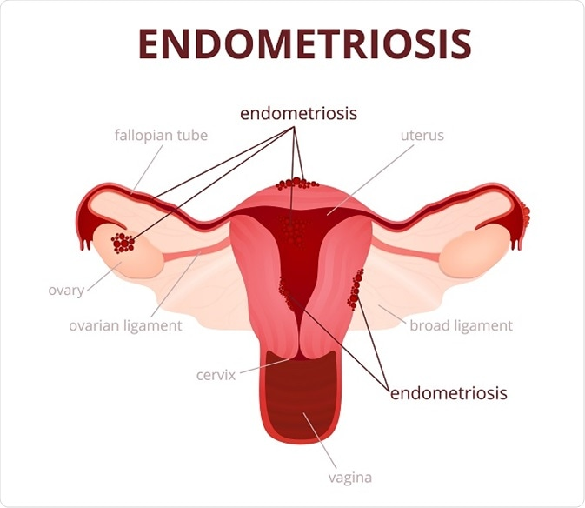
Dysmenorrhea
  Dysmenorrhea: pain during menstruation.
  May be a part of PMS or PMDD, or disorder by itself.
  Secondary dysmenorrhea: when there is an underlying disorder, most common cause being:
    Endometriosis: uterine tissue grows in other parts of the abdominal cavity.
  Primary dysmenorrhea: when there is no underlying disorder.

Slide 18
Menstrual Cramping
  Menstrual cramping: painful contractions of the uterine muscles during the menstrual phase.
  Help the body expel the dead tissue from the uterus.
  Triggered by an excess production of prostaglandins.

Slide 19
Climacteric
  Climacteric: hormonal and physiological changes occurring in mid-life in both sexes.
  Perimenopause: a period of time when ovaries produce less estrogen:
    Menstruation may become less regular.
    Women may notice changes in sex drive.
  Menopause: permanent cessation of ovulation and menstruation.
    Triggered in part because of a depletion of oocytes.

Slide 20
Symptoms of Menopause
  Thinning of the vaginal walls
  Decrease in vaginal lubrication, sexual desire and/or arousal
  Acceleration of bone loss
  Irritability
  Sleep disturbances
  Hot flashes and/or temperature sensitivity
  Dizziness
  Numbness and/or tingling in the hands and feet
  Difficulty concentrating

Slide 21

Andropause
  Andropause: gradual decline of sex hormones that occurs in mid-life.
  Reduction in testosterone.
  Occurs in males.
  Accompanied by changes in mood and reductions in sex drive.

Slide 22
Hormone Therapy
  Administering sex hormones to treat:
    Low sexual desire or arousal problems.
    Symptoms of perimenopause, menopause, or andropause.
  Menopausal hormone therapy (MHT):
    Treatment to replace the naturally-reduced levels of androgens and/or estrogen in order to:
      Reduce discomfort.
      Ameliorate changes in sexual functioning.
      Slow the changes associated with aging.
    Ways to administer sex hormones:
    Vaginal creams
    Injected hormones
    Intravaginal rings with a time-release function inserted into the vagina
    Transdermal patches

Slide 23
Research Focus
  Baker, 2006; Tourmente, Gomendio, & Roldan, 2011:
    Individual sperm cells vary in quality and function:
      Some block other sperm cells, while some facilitate the movement of other sperm cells.
        Has significance for mammals with polyandrous mating.
        For humans, it is left over from ancient mammalian evolution.

Slide 24
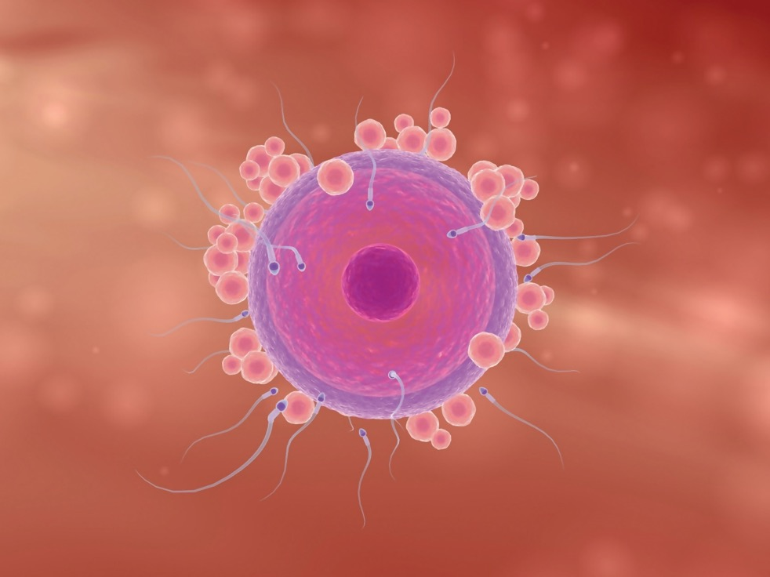
Human Gametes

Slide 25
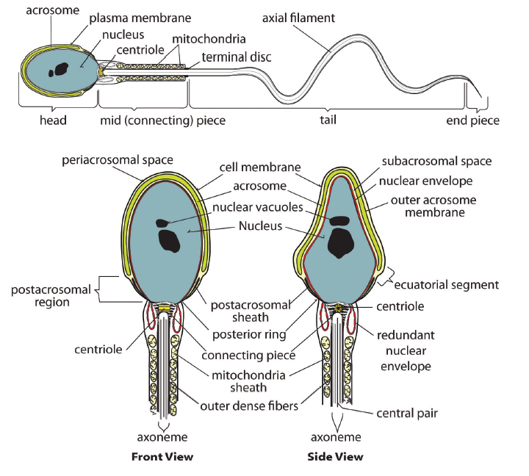
Human Gametes (continued)

Slide 26
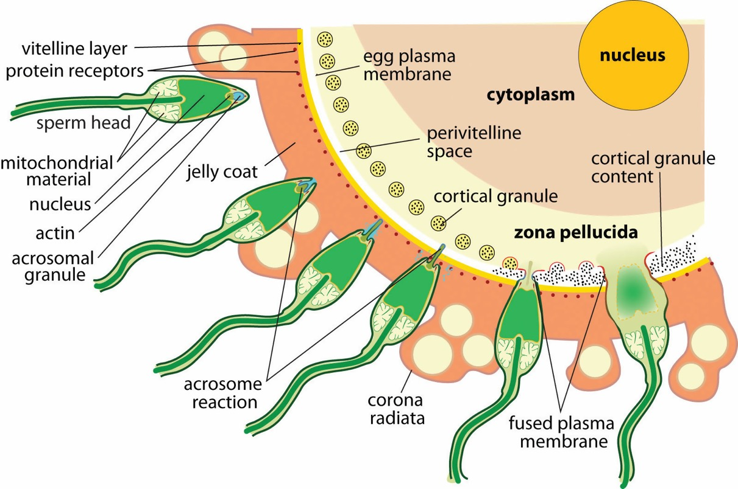
Human Gametes (continued)

Slide 27
Conception: Fertilization and Implantation
  Semen is deposited into the vagina near the part of the cervix which forms the opening to the uterus.
  Sperm take close to 12 hours to reach fallopian tubes:
    Live inside the uterus and fallopian tubes for a week.
  A mature ovum dies within 24 hours of ovulation if it is not fertilized.
  Intercourse shortly before ovulation is most likely to result in fertilization.
  Upon fertilization:
    Conceptus develops into a blastocyst.
    Blastocyst sends chemical signals causing it to:
      Implant into the wall of the endometrium.
      Form connections with blood vessels.
      Secrete progesterone that prevents menstruation.

Slide 28
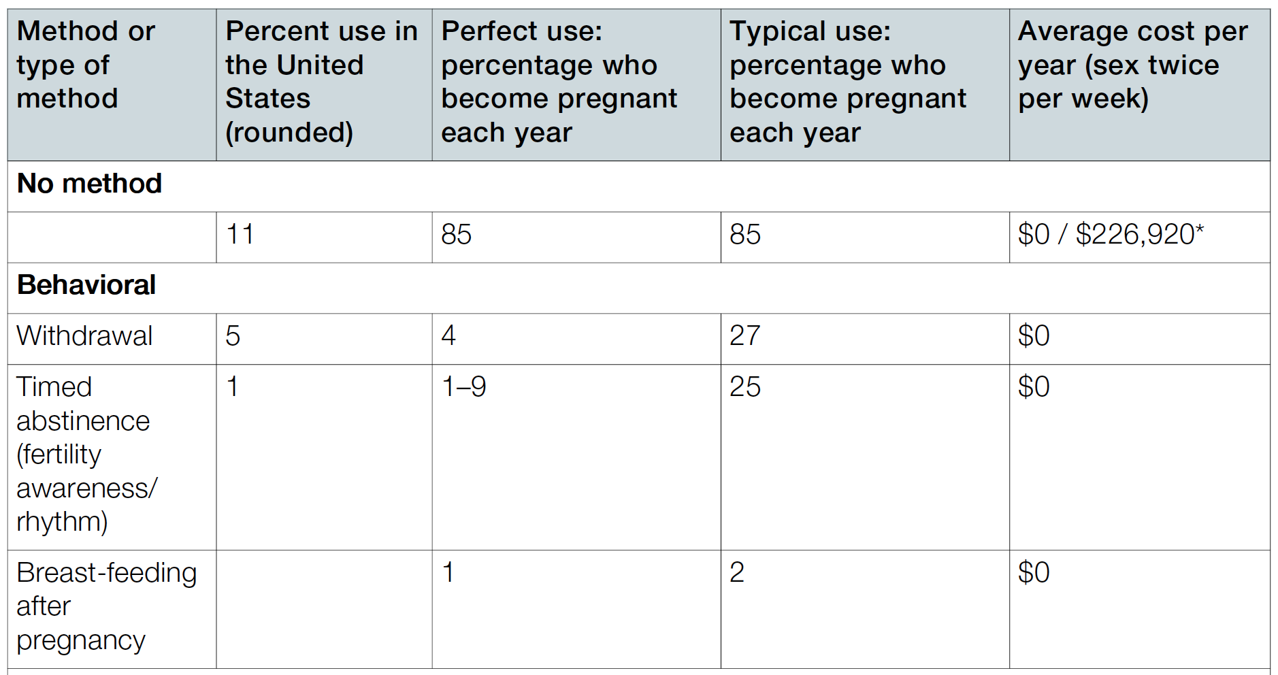
Estimates of Contraceptive Usage, Effectiveness, and Costs

Slide 29
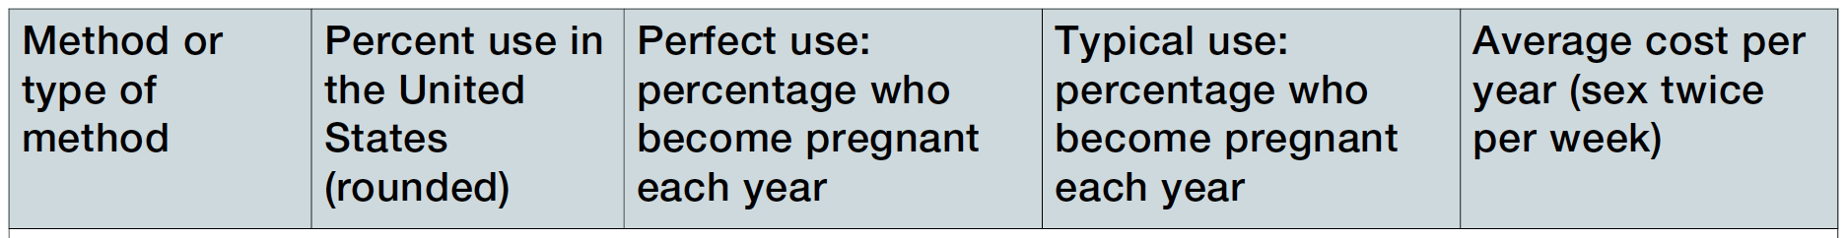
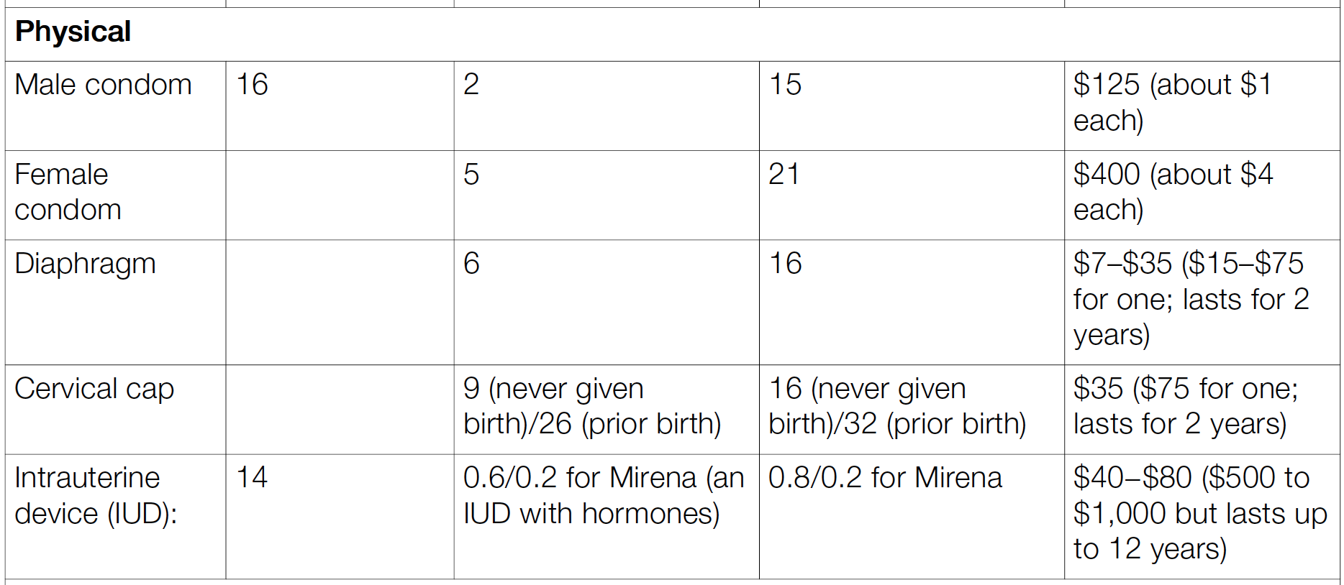
Estimates of Contraceptive Usage, Effectiveness, and Costs (continued)

Slide 30
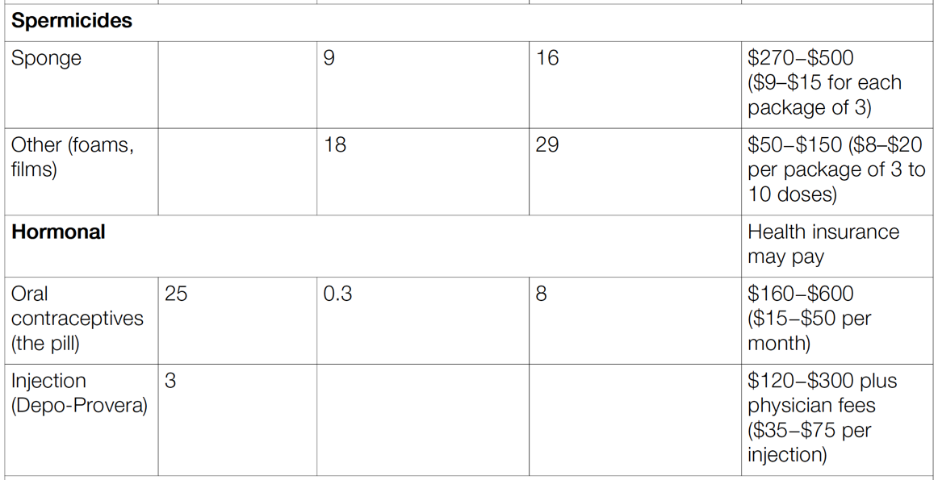
Estimates of Contraceptive Usage, Effectiveness, and Costs (continued)

Slide 31
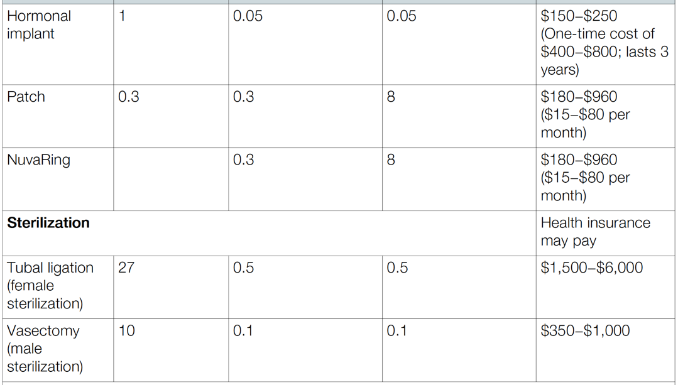
Estimates of Contraceptive Usage, Effectiveness, and Costs (continued)

Slide 32
Behavioral Methods
Avoid conception by not ejaculating inside the vagina.
Least effective.
Withdrawal: male withdrawing his penis from a female’s vagina prior to ejaculating.

Slide 33
Fertility Awareness Methods
Indirect monitoring of ovulation and timing coitus to non-fertile times.
Includes periodic abstinence (rhythm) and monitoring the body’s internal temperature.
Also used when individuals want to conceive.
Cervical mucous method.

Slide 34
Sex During Menstruation
Physically safe.
Precautions against STIs need to be taken.
Possibility of getting pregnant:
  Sperm cells in semen can survive for up to 5 days and can swim past the menses into the fallopian tubes.

Slide 35
Contraception During Perimenopause and Menopause
Probability of becoming pregnant decreases after 40 years of age.
Ovulation and menstruation is erratic during perimenopause:
  Use of contraception is required to avoid pregnancy.
Recommendation from medical authorities:
  Contraception be continued for 24 months after last spontaneous (natural) menstruation.

Slide 36
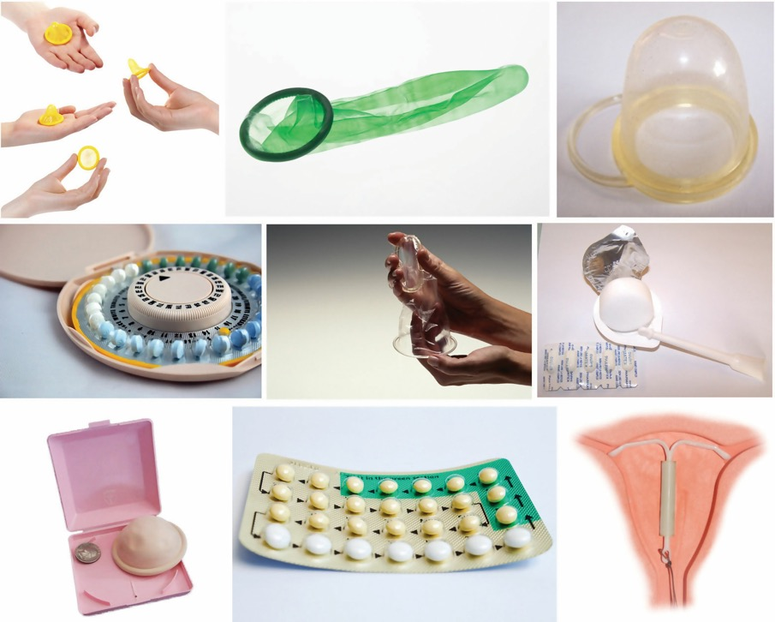
Contraceptives

Slide 37
Contraception Methods
Condoms: a barrier method that captures semen to prevent ejaculation.
  Female condoms are worn by a female inside her vagina secured on the vulva.
Cervical cap / diaphragm: vaginally inserted barriers, placed against the cervix, used in combination with spermicides.
  Are reusable.
Intrauterine device (IUD): a device placed in the uterus to prevent implantation.
Spermicide: affects sperm motility and provides a barrier to the cervix.

Slide 38
Contraception Methods
Hormonal contraceptive: hormonal agents that block contraception primarily by blocking ovulation.
  May be taken orally or in the form of implants, injections, patches, IUDs, and vaginal rings.
  Combination pill: contains and estrogen and a progestin.
  Progestin-only pill (mini-pill).
Sterilization: surgical method of permanent contraception.
  Vasectomy – in males
  Tubal ligation – in females
Hysterectomy: a surgical procedure in which the uterus is removed.
  Performed for a variety of conditions including menstrual disorders.
  Results in sterilization.

Slide 39
Contraception Methods
Reversible inhibition of sperm under guidance:
  Is in experimental stages.
  Involves injecting a synthetic viscous polymer (a type of liquid) into the vas deferens.
  Positively charged polymer makes the sperm inert.
Emergency contraceptives: hormonal contraceptives designed to prevent conception after contraception was not used or failed but pregnancy would be unwanted.

Slide 40
Family Planning
The idea of pregnancy being an intended event as well as the technologies that make this possible.
Is intimately tied with deeply held religious beliefs and political controversies.

Slide 41
History of Abortion
Documents of inducing abortion deliberately date to almost 5000 years ago.
Use of abortifacients is widely documented in many pre-industrial cultures.
In the mid-1800s the American Medical Association took a formal position against abortion.
  States began to outlaw abortion because women were dying from unsafe methods
Formal campaigns made abortion illegal in Europe and America.

Slide 42
Objections to Abortion
Primarily moral ones based on prohibitions against murder.
Strongly connected to religious beliefs.
Secular prohibitions against murder are based on the concept of personhood:
  Existence of a nervous system and developed brain capable of self-awareness.

Slide 43
Legalization of Abortion
Soviet Union legalized abortion in 1920, reversed the law in 1936, and re-legalized elective abortion in 1955.
Laws were revised in Western countries to permit abortion for medical necessity.
In 1967, abortion was legalized for all reasons in England, up to 28 weeks after conception.

Slide 44
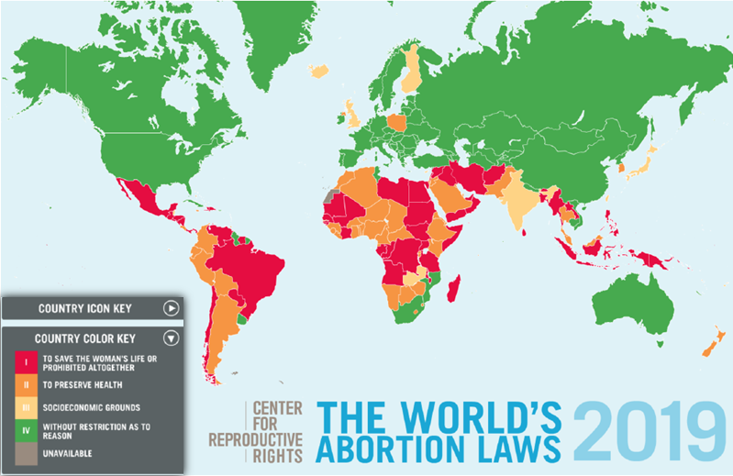
Abortion Laws Worldwide

Slide 45
Abortion Today
In countries where abortion is illegal it is reported that approximately 1 in 8 pregnancy-related deaths are due to complications from illegal abortion.
Individuals who believe abortion is murder seek to restrict or recriminalize abortion.
Pro-life movement: favors of restrictions on abortion and seek rights to:
  Stage permanent protests outside of clinics that offer abortions.
  Limit tax money for paying for abortion.
Pro-choice movement: favors legalized abortion and seeks to:
  Keep access to abortion legal and safe.
  Focus on issues of availability and access, particularly to those with limited financial means.

Slide 46
Methods of Abortion
Vary by trimester
Medical abortions:
  Can be performed up to 7-9 weeks after the start of the last menstrual cycle.
  Involve administering 2 drugs in sequence:
    1st affects the fetus or induces the lining of the endometrium to fall away.
    2nd induces uterine contractions to expel the remains of the fetus and endometrial lining.
    More expensive than surgical abortions.
Surgical abortions:
  Can be performed up to 11-12 weeks.
  Involve dilating the cervix and then inserting a vacuum cannula:
    Breaks up the embryo or fetus and removes it from the uterus.
  A curette is used to clean the walls of the uterus and reduce subsequent bleeding.

Slide 47
Methods of Abortion
Dilation and evacuation:
  Used in second trimester.
  On the first day, a stick is inserted into the cervical canal under general anesthesia:
    Absorbs fluid and slowly dilates the cervix.
  On the second day, a suction cannula is used to remove the fetus and placental tissue and fluid.
  Involves greater risk of bleeding and complications.

Slide 48
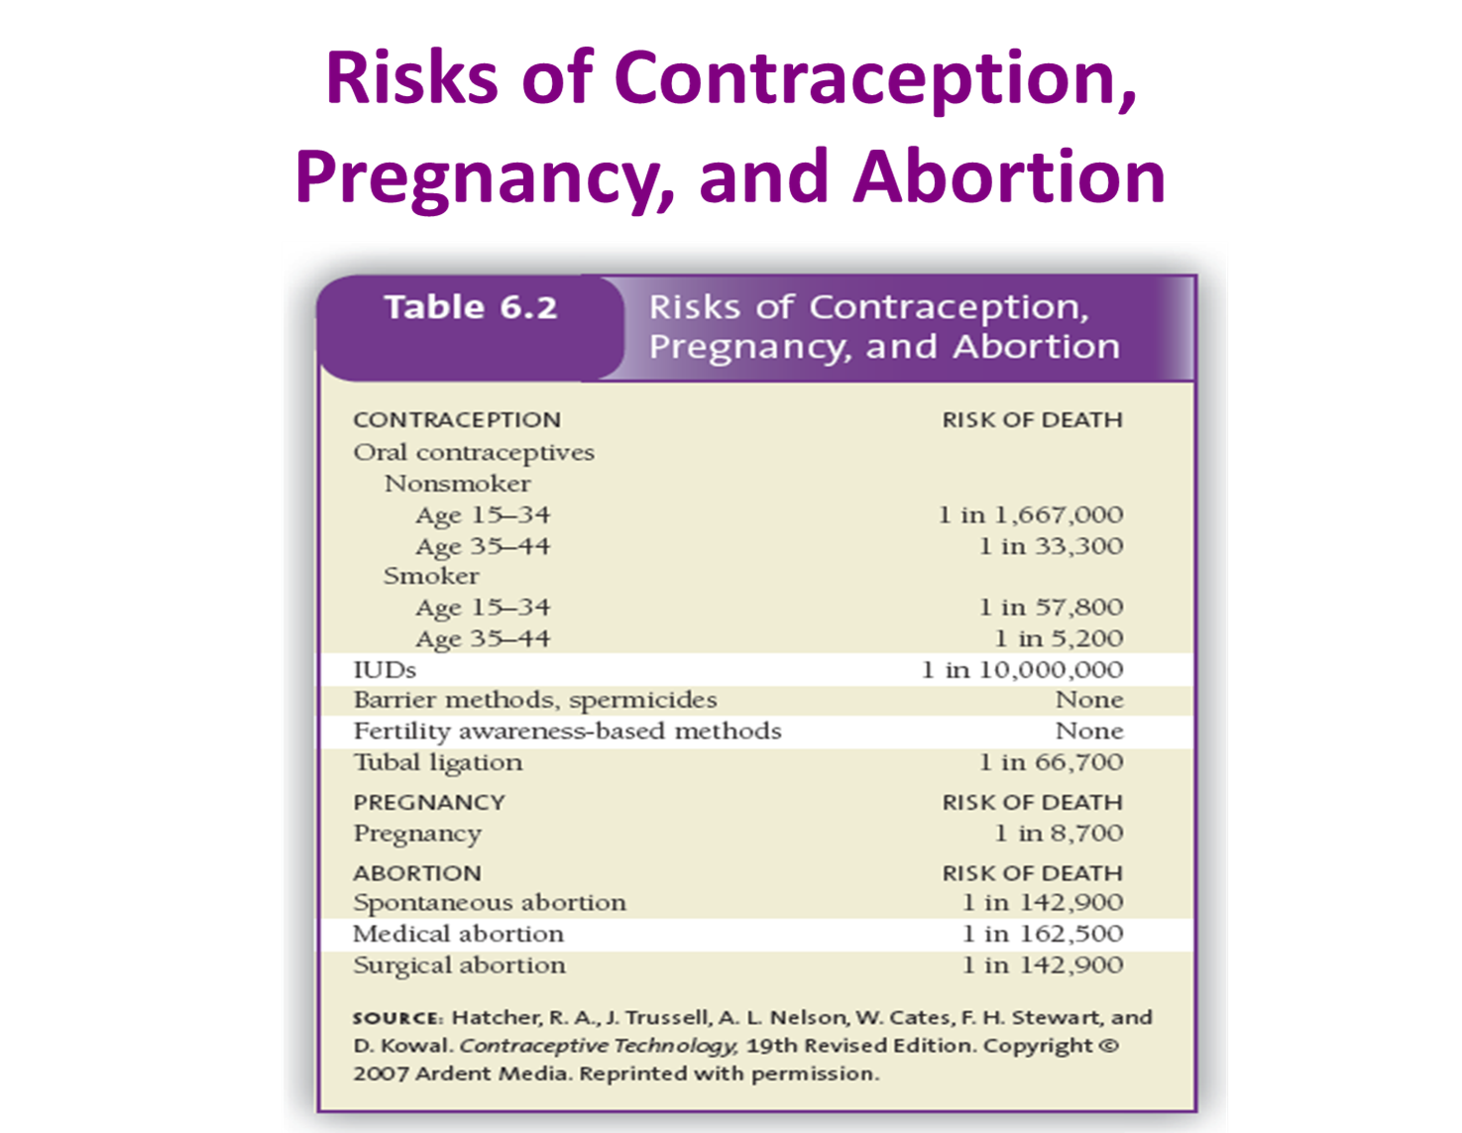

Slide 49
Effects of Abortion
Coitus should be avoided for two weeks.
Laws require notifying of potential long term psychological and health problems in future fertility.
Research indicates that:
  Abortion itself is not associated with more mental health problems.
  Medically safe abortion does not itself have long term health consequences for the vast majority of women.

Slide 50
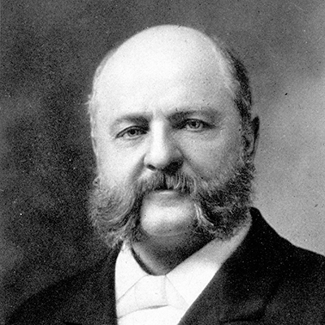
Comstock Laws
Passed in 1870s.
Banned the distribution or sale of sexually explicit or obscene materials.
Formed the basis for prohibiting:
  Contraceptives.
  Information on sexuality and contraception.
  Pornography.

Slide 51
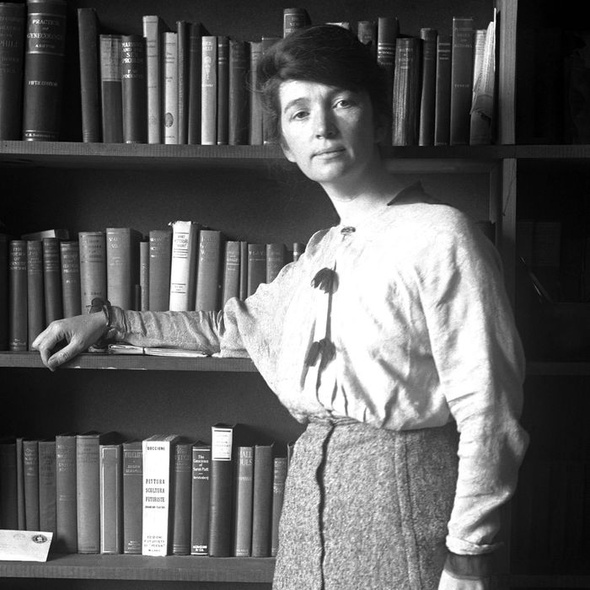
Margaret Sanger
Most successful advocate for effective planning information.
Published a newsletter advocating birth control.
Founded the first birth control clinic in the U.S. in Brooklyn, New York.
Found several organizations and committees which lobbied for legalization of birth control.

Slide 52
Modern Obstacles to Contraception
Switching contraceptive methods:
  Some methods may take time before efficacy begins.
Some formulations of oral contraceptives negatively affect breast milk production.
Religious teachings present a great obstacle to contraceptive access.

Slide 53
Family Planning and Unintentional Pregnancy
Planned pregnancy is associated with better:
  Maternal health.
  Psychosocial adjustment for the entire family.
Cultural norms determine desirable family size.
Unintentional pregnancies are those that a woman does not want, or does not want at that time:
  Result from lack of access to:
    Contraception.
    Information about contraception.

Slide 54
Forced Sterilizations
Were carried out on people with developmental disabilities and cognitive impairments:
  Considered unethical in modern times.
Are legally administered to individuals whose impairments would create difficulty with parenting.
Reproductive rights of those with severe cognitive impairment remain an ethical difficulty.
Administering contraceptives may be appropriate for individuals lacking the capacity to make informed decisions about reproduction.

Slide 55
Demographic Changes and the Environment
Demographers estimate that eventually population growth will slow and indeed reverse.
Strong negative correlation between fertility and income levels and education:
  Fertility rate: average number of births per woman.
Fertility rates and population growth are influenced by:
  Family planning policies.
  Education and economic development.
  Religious beliefs and practices.

Slide 56
Demographic Changes and the Environment
Large family sizes in developing countries are due to:
  Limited education and limited access to contraception.
  High rates of infant mortality.
  Children as a source of labor and support.
According to environmental scientists, world population has reached unsustainable levels:
  Current levels of energy and resource use will have potentially catastrophic impacts on the biosphere.

